Slide 1
SMART IRRIGATION SYSTEM - by Group No. 1
Students Name : Rishi Raj Pradhan Roll No.211000045
Students Name : Priyanshu Sidar Roll No.211000040
Students Name : Eshita Pradhan Roll No.211000018
Guided by
Dr. Rajesh Ingle
International Institute of Information Technology, Naya Raipur

Slide 2
PROBLEM STATEMENT
In today’s world, we all are relying on farmers. But anyone knows who farmers rely on? Nobody, they “suffer from various irrigation difficulties like over-irrigation, under irrigation, depletion of underwater, floods, etc. . “
To overcome some of the problems we are trying to make a project which can help farmers to overcome the difficulties.
Over irrigation occurs because of poor distribution or the lack of management wastes water, chemicals, and may lead to water pollution.
Under irrigation is giving only just enough water for the plant which gives poor soil salinity which leads to increased soil salinity with a consequent build-up of toxic salts in soil surface in areas with high evaporation. This requires either leaching to remove these salts and a method of drainage to carry the salts away. To overcome these irrigation difficulties we have made a project by the use of IoT and ML. The hardware consists of various sensors like temperature sensor, humidity sensor, ph sensor, pressure sensor operated by raspberry pi module and bolt IOT module.

Slide 3
OUR SOLUTION
Our temperature and humidity sensor will measure the weather condition of that area through which farmer will make less use of water in the fields.
Our soil moisture sensor will sense the moisture of the soil at a regular interval and predict whether that soil needs more water or not.
Our main target is to make an irrigation system automatically and to save water for the future purpose.

Slide 4
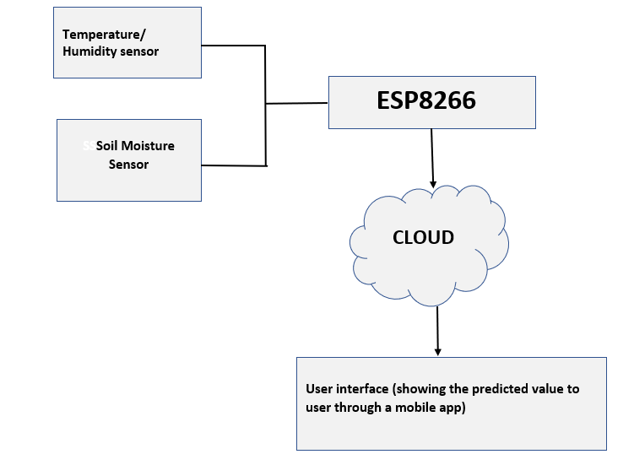
SENSOR NODE

Slide 5
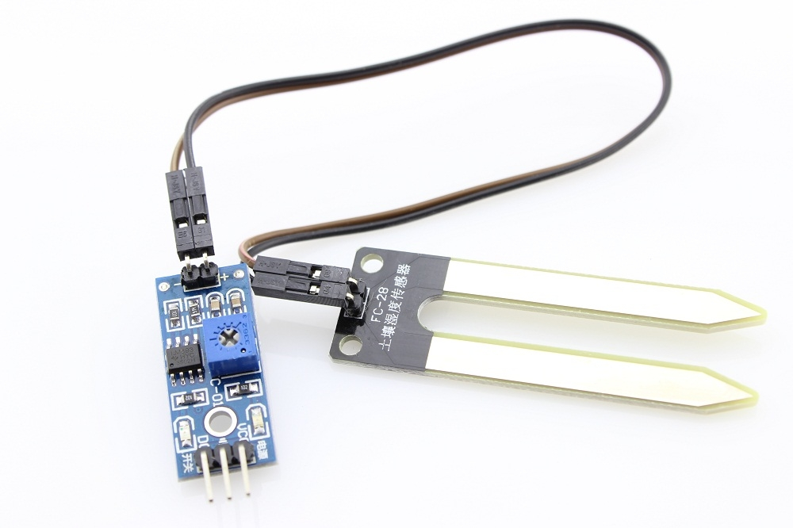
SOIL MOISTURE SENSOR
The soil moisture sensor is one kind of sensor used to gauge the volumetric content of water within the soil. As the straight gravimetric dimension of soil moisture needs eliminating, drying, as well as sample weighting. These sensors measure the volumetric water content not directly with the help of some other rules of soil like dielectric constant, electrical resistance, otherwise interaction with neutrons, and replacement of the moisture content.
Soil Moisture Sensor Pin Configuration
The FC-28 soil moisture sensor includes 4-pins
VCC pin is used for power
A0 pin is an analog output
D0 pin is a digital output
GND pin is a Ground

Slide 6
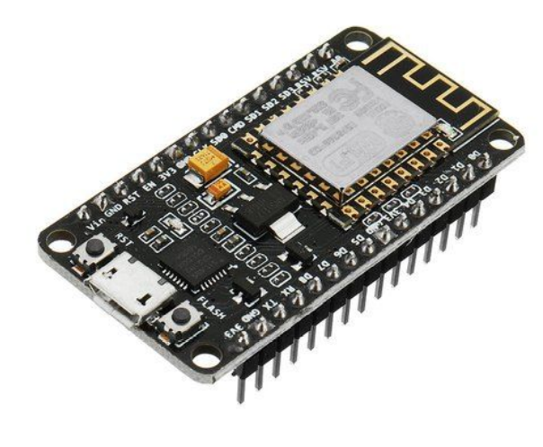
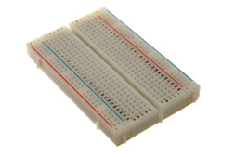
ESP8266 BREADBOARD
The ESP8266 WiFi Module is a self contained SOC with integrated TCP/IP protocol stack that can give any microcontroller access to your WiFi network. The ESP8266 is capable of either hosting an application or offloading all Wi-Fi networking functions from another application processor.
Breadboard is a rectangular plastic board with a bunch of tiny holes in it. These holes let you easily insert electronic components to prototype (meaning to build and test an early version of) an electronic circuit, like this one with a battery, switch, resistor, and an LED (light-emitting diode).

Slide 7
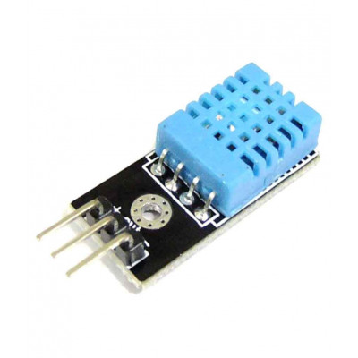
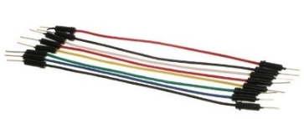
DHT 11
DHT11 is a Humidity and Temperature Sensor, which generates calibrated digital output. DHT11 is a low cost humidity and temperature sensor which provides high reliability and long term stability.
It uses a capacitive humidity sensor and a thermistor to measure the surrounding air, and outputs a digital signal on the data pin (no analog input pins needed). Its very simple to use.
JUMPERWIRE
Jumper wires have pins and connectors that are used to connect different components on a breadboard

Slide 8
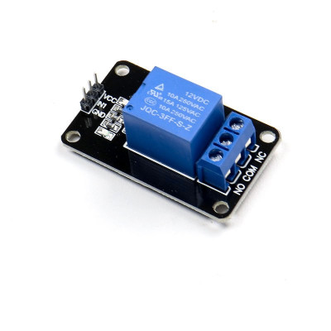
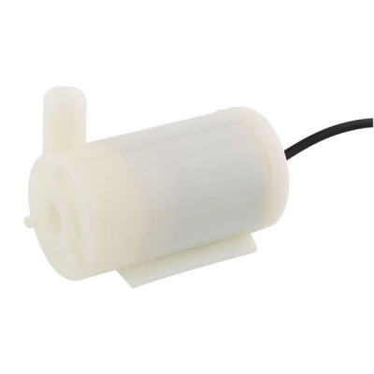
RELAY MODULE PUMP
The relay is the device that open or closes the contacts to cause the operation of the other electric control. It detects the undesirable condition with an assigned area and gives the commands to the circuit breaker to disconnect the affected area through ON or OFF.
Micro DC 3-6V Micro Submersible Pump Mini water pump This is a low cost, small size Submersible Pump Motor which can be operated from a 3 ~ 6V power supply. It can take up to 120 liters per hour with very low current consumption of 220mA.

Slide 9
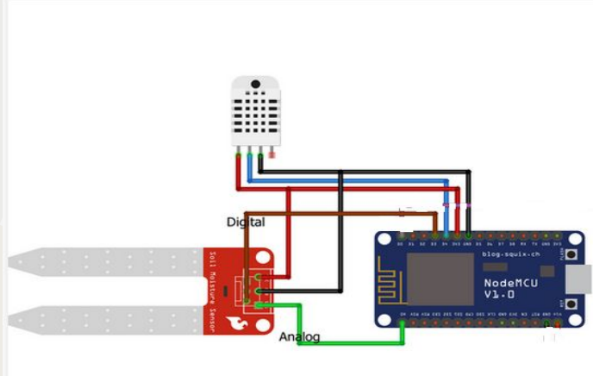
CIRCUTE DIAGRAM

Slide 10
WORKING PRINCIPAL
The soil moisture content and environmental factors like temperature and humidity are read by the microcontroller of the transmitter module.
These values are sent to the cloud through internet for every 30 seconds . The logged data is represented in the ThingSpeak cloud in the form of graphs.
When the sensors values go beyond the threshold, an alert message is sent to the farmer. Android Application enables farmer to turn on the water motor by controlling the relay connected to coordinator module through internet.
When the desired environmental parameters are met an alert is sent again to the farmer to turn off the motor.

Slide 11
CONCLUSION
The proposed system provides the efficient and reliable method of irrigation. Due to regular updates of the soil conditions and environmental factors, it becomes easy to analyse the data and get knowledge about what amount of water is required at what interval of time in a day. Moreover in dry areas where there is inadequate rainfall, the system can efficiently manage water and ensure better yield of crops by precisely watering. The system reduces human intervention. It enables the farmer to know about the crops and surrounding environment and control the water pump and monitor the field by accessing the data from anywhere.

Slide 12
FUTURE SCOPE
From coming week we will work on data computing. Using machine learning and algorithms we will predict how much water is needed and will send the message or notification to the farmer
We can introduce a list of predefined soil moisture value required for different plants according to their need.

Slide 13

Thank You!
..
Dr. Shyama Prasad Mukherjee International Institute of Information Technology, Naya Raipur

